Slide 1

Welcome To Coffee Shop
Proprietor: MD Shakib

Slide 2
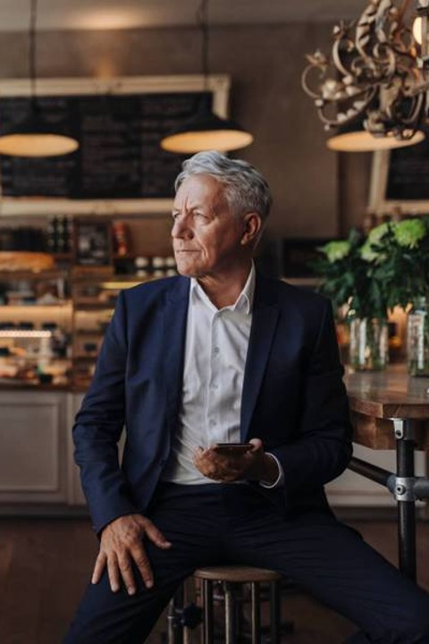
Introduction
coffee, beverage brewed from the roasted and ground seeds of the tropical evergreen coffee plants of African origin. Coffee is one of the three most popular beverages in the world (alongside water and tea) and one of the most profitable international commodities. Though coffee is the basis for an endless array of beverages, including espresso, cappuccinos, mochas, and lattes, its popularity is mainly attributed to its invigorating effect, which is produced by caffeine, an alkaloid present in coffee.resent in coffee.

Slide 3
​SL NO | Category ​ | Price
Cold Coffee | Full | 150 taka
Black Coffee | Full | 1​25 taka
Sweet Coffee | Full​ | 120 taka
Hot Coffee | Full | 60 taka

Slide 4
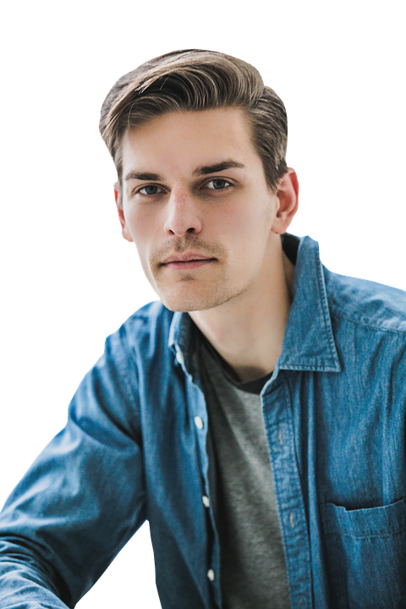
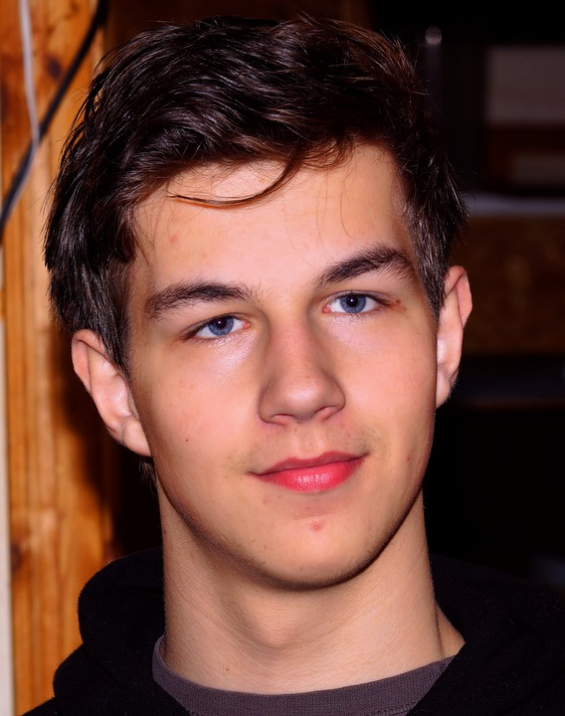

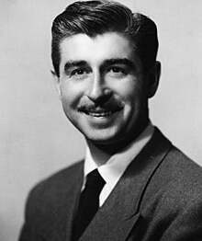

Team Membar
This Photo by Unknown Author is licensed under CC BY-SA
Ashad
Tahmid
Omor
Hira
Mennear
Senior Chef
Junior Chef
Worker

Slide 5

Summary
Facility coffee is a locally owned coffee shop that features expertly crafted coffee and espresso drinks. We use responsibly sourced, high
quality beans that are roasted a few miles away on St Simons Island. We also offer protein and pre-workout drinks (made from whole food ingredients- no chemicals or preservatives!), breakfast pastries, desserts, and more.

Slide 6

Thank you
Coffee Zone
ashadhossen612@gmail.com

